Slide 1


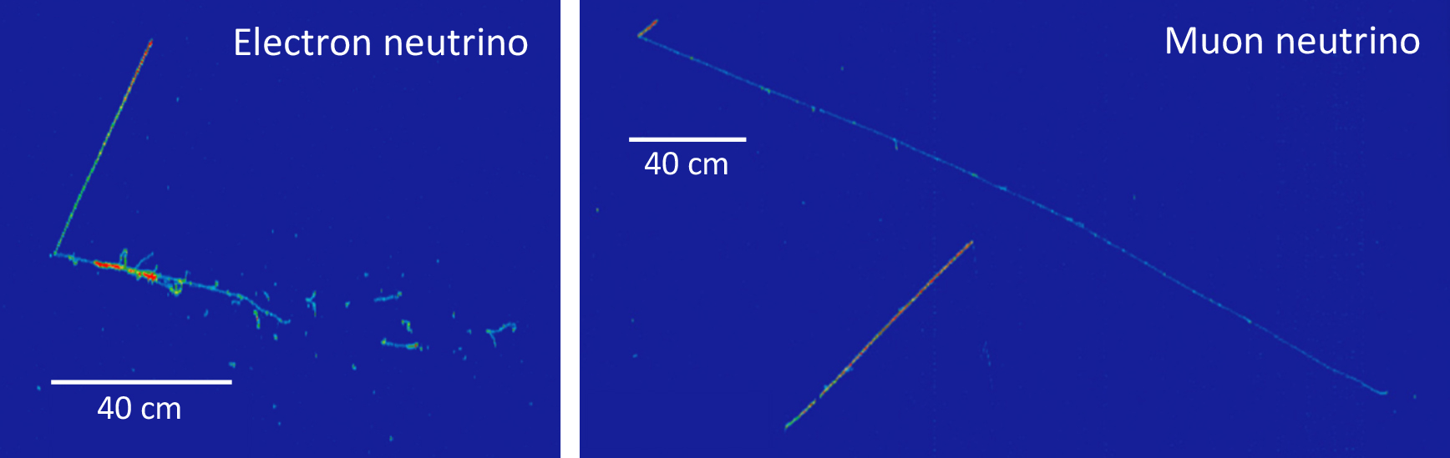
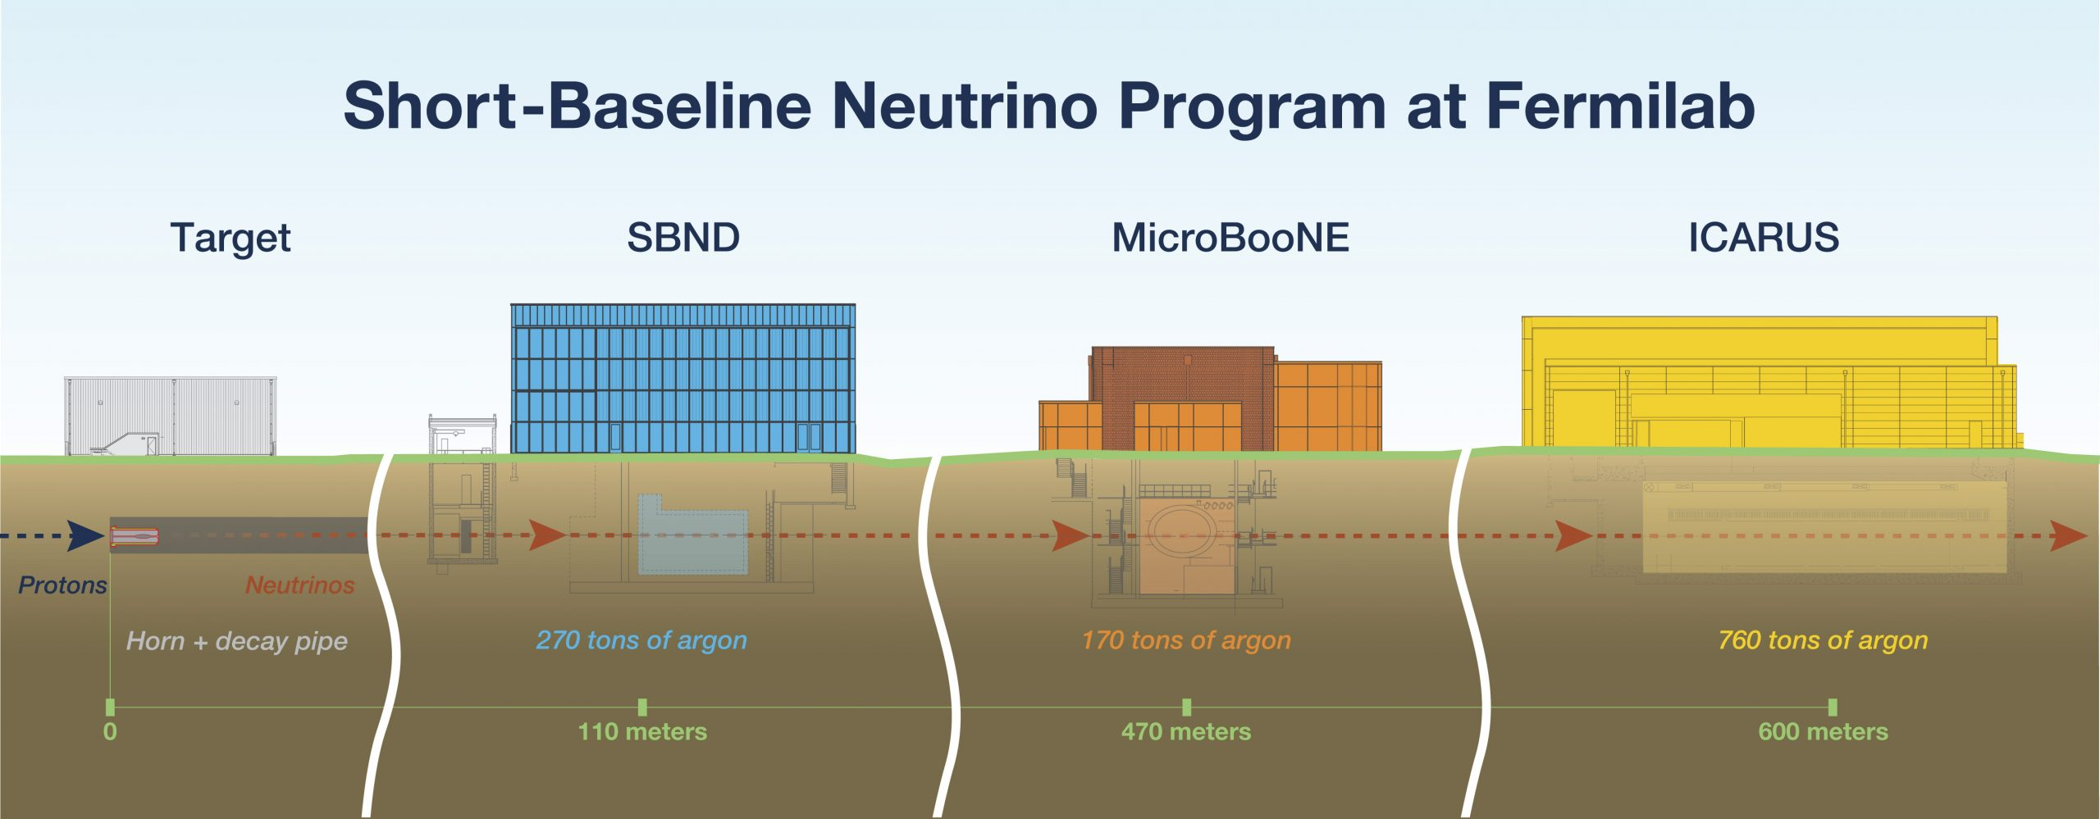

Trigger Efficiency Analysis in the ICARUS Neutrino Detector
Tanvi Krishnan¹, Gianluca Petrillo²
¹Harvey Mudd College, Claremont, CA;
²SLAC National Accelerator Laboratory, Menlo Park, CA
Introduction
e⁻ drift
Anode
Wire Planes
In Figure 7, it is also clear that with the original trigger emulation window (black lines) we would prevent many tracks from triggering as their light would appear outside the window, especially in the West cryostat. Shifting the window (red lines) should allow more of the West cryostat tracks to trigger. Using the shifted window, trigger efficiencies in the West cryostat improved, but worsened in the East cryostat. Further study is required to understand why the shifting window specifically affects 2m tracks and how we can increase trigger efficiency in the East cryostat.
Neutrinos are nearly massless, neutrally charged elementary particles formed as a byproduct of nuclear reactions. They have many potential applications, such as in nuclear weapons safety and supernova research, but we need to first develop a better understanding of their properties, which is the goal of neutrino detectors like ICARUS.
scintillation light
Cathode
Neutrino
Secondary
Particles
e⁻
PMTs
Figure 3. Schematic of a Liquid Argon Time Projection Chamber (LArTPC) in ICARUS
Trigger Overview
The trigger is a hardware system in the detector that filters out background in real time. We can emulate its performance using software to test different light sensitivity levels. Each light sensitivity level consists of a certain number of PMT pairs that must exceed a fixed threshold of light in order to cause us to record an event. The light sensitivity levels we tested are M1 (1 PMT pair exceeds threshold within entire detector) and S3, S5, S8, S10, and S15 (3-15 PMT pairs exceed threshold within 1 of 3 6m sections of detector). We hope to select the sensitivity level that maximizes efficiency of recording desired tracks while minimizing background accumulated.
Figure 5. Efficiency as a function of track length in the East cryostat for different light sensitivity levels. Vertical error bars show a 68% CI using an exact Clopper-Pearson interval, while horizontal error bars depict the size of the bins.
(a)
(b)
The 2m Track Anomaly
Figure 1. Neutrino events in the ICARUS detector. (a) Electron neutrino entering detector from the left, interacting to turn into an electron and a secondary particle. (b) Muon neutrino entering detector from the top left, interacting to turn into a muon (long track) and secondary particle (short track). Image credits: ICARUS collaboration
When zooming in on Figure 5 to tracks around 2m in length, there is a noticeable drop in efficiency (Figure 6). We refer to this as the 2m track anomaly.
Detector Overview
ICARUS (Imaging Cosmic and Rare Underground Signals) is a Liquid Argon Time Projection Chamber (LArTPC) detector which creates digital images of neutrino interactions to better understand their properties. It is the far detector in the Short Baseline Neutrino Program at Fermilab (Figure 2).
Light > Sensitivity
Figure 7. Light-Track Time Difference Compared to Trigger Emulation Windows.
True
False
Conclusions
Record
Ignore
Further analysis is required to understand the physical meaning behind the 2m track anomaly. A new “minimum bias” run was collected in late July and repeating previous analysis with the new dataset will hopefully allow us to better understand this issue and understand detector changes and improvements over the past 6 months. Future analysis will include a broader sample, containing tracks that don’t necessarily cross the cathode, methods for which are currently being developed.
Figure 4. ICARUS Trigger System Logic.
Data Overview
This data comes from a “minimum bias” run (data collected without hardware trigger constraints). We used software to emulate trigger performance under different light sensitivity levels. We only analyzed cathode-crossing tracks from this sample since those are the only tracks for which we can reconstruct track time without biasing our efficiency measurement.
Figure 6. Efficiency of Trigger as a function of Track length in the East cryostat for tracks 150-300 cm in length.
This feature is especially evident in the East cryostat but is also present to a lesser extent in the West cryostat. There is no noticeable spatial pattern within the detector for these 2m tracks that fail to trigger. However, statistics are limited for the dataset currently used in this analysis. A newer run may be able to provide more insight on this issue.
One possible solution may be shifting the trigger emulation window. In the trigger emulation software, for a given track occurring at time t0, light in a 20µs window before t0 is checked against the different light sensitivity levels to determine triggering. Looking at the raw PMT data, many of the ~2m tracks that failed to trigger was paired with light detected by the PMTs <5µs after t0 that would be missed by the trigger. We shifted the window back by 5 µs to see whether the overall trigger efficiency improved.
Figure 2. Overview of SBN at Fermilab. Image credits: ICARUS collaboration
The detector is composed of two semi-independent cryostats (East and West), each containing two LArTPCs. The wire planes in each LArTPC register drifting electrons from particle interactions within the detector, on the order of milliseconds, and the PMTs (photomultipliers) detect scintillation light on the order of nanoseconds (Figure 3). In the time it takes the electrons from a neutrino event to drift to the wire planes, about 20 cosmic rays (background) pass through the detector. Light travels much faster than the drifting charge so we can use the PMT data to distinguish cosmic rays from neutrino events, which we are looking to study. We can then reconstruct and analyze the neutrino events.
Acknowledgements
Trigger Efficiency
I would like to acknowledge Dr. Gianluca Petrillo for his guidance and mentorship throughout this program, the ICARUS Trigger Working Group and the SLAC Neutrino Group for their support, Erin and Hillary for organizing the program, my fellow interns. This work was supported in part by the U.S. Department of Energy, Office of Science, Office of Workforce Development for Teachers and Scientists (WDTS) under the Science Undergraduate Laboratory Internships Program (SULI).
The formula we used for calculating efficiency is:
$$\text{Efficiency}= \frac{\text{selected} \text{tracks} \text{that} \text{would} \text{trigger}}{\text{selected} \text{tracks}}$$
We first looked at efficiency as a function of track length in both cryostats. Efficiency is higher for longer tracks (Figure 5) since longer tracks generally have more energy and generate more light, so are more likely to be picked up by the trigger. The same trend is seen both in the East cryostat (Figure 5) and the West cryostat.

